Slide 1


Mtech (Advance Computing and Data Science in collaboration with CDAC)
Advance Database
Fakhre Alam
Reg. No.179305004
PRN No. 170831180004

Slide 2
Metadata Management
Mtech (Advance Computing and Data Science in collaboration with CDAC)
Fakhre Alam
Reg. No.179305004
PRN No. 170831180004

Slide 3
Mtech (Advance Computing and Data Science collaboration with CDAC)
Content
This module contains..
An explanation of what is metadata.
An outline of the Metadata lifecycle.
An introduction to Metadata quality.
An overview of the metadata management and exchange approach implemented by Open Data Support through the Open Data Interoperability Platform .

Slide 4
Mtech (Advance Computing and Data Science collaboration with CDAC)
What is metadata?
Definition, examples and reusable standards .

Slide 5
Mtech (Advance Computing and Data Science collaboration with CDAC)
What is metadata?
“Metadata is structured information that describes, explains, locates, or otherwise makes it easier to retrieve, use, or manage an information resource. Metadata is often called data about data or information about information.”
-- National Information Standards Organization
http://www.niso.org/publications/press/UnderstandingMetadata.pdf
Metadata provides information enabling to make sense of data (e.g. documents, images, datasets), concepts (e.g. classification schemes) and real-world entities (e.g. people, organisations, places, paintings, products).

Slide 6
Mtech (Advance Computing and Data Science in collaboration with CDAC)
Types of metadata
Descriptive metadata- Describes a resource for purposes such as discovery and identification. It can include elements such as title, abstract, author, and keywords.
Structural metadata- Indicates how compound objects are put together. Example: How pages are ordered to form chapters, data models and reference data.
Administrative metadata-Provides information to help manage a resource. Such as when and how it was created, file type and other technical information and who can access it.

Slide 7
Mtech (Advance Computing and Data Science in collaboration with CDAC)
Managing the
metadata of
your datasets

Slide 8
Mtech (Advance Computing and Data Science in collaboration with CDAC)
Metadata management is important
Metadata needs to be managed to ensure ...
• Availability: Metadata needs to be stored where it can be accessed and indexed so it can be found.
• Quality: Metadata needs to be of consistent quality so users know that it can be trusted.
• Persistence: Metadata needs to be kept over time.
• Open License: metadata should be available under a public domain license to enable its reuse.
The metadata lifecycle is larger than the data lifecycle:
• Metadata may be created before data is created or captured, e.g. to inform about data that will be available in the future.
• Metadata needs to be kept after data has been removed, e.g. to inform about data that has been decommissioned or withdrawn.

Slide 9
Mtech (Advance Computing and Data Science in collaboration with CDAC)
Metadata Schema
“A labelling, tagging or coding system used for recording cataloguing information or structuring descriptive records. A metadata schema establishes and defines data elements and the rules governing the use of data elements to describe a resource.”

Slide 10
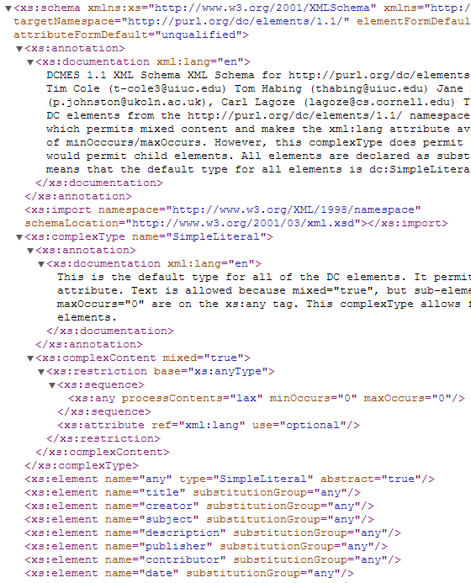
XML Schema

Slide 11
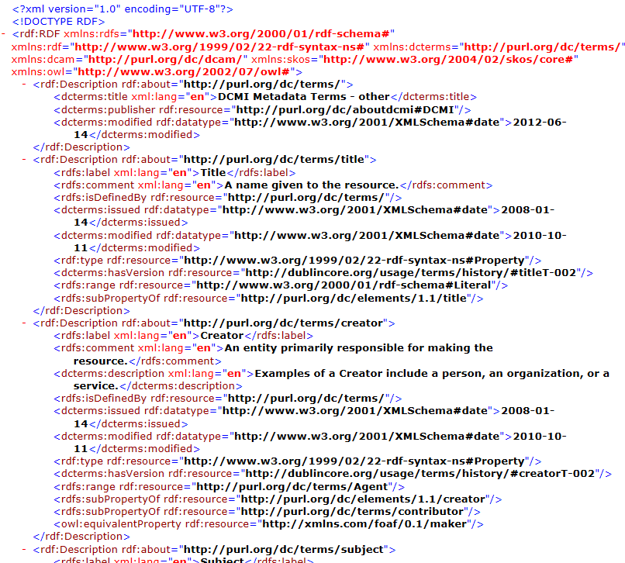
RDF Schema

Slide 12
Mtech (Advance Computing and Data Science in collaboration with CDAC)
Reuse existing vocabularies for providing metadata to your resources
General purpose standards and specifications:
Dublin Core for published material (text, images),
http://dublincore.org/documents/dcmi-terms/
FOAF for people and organisations, http://xmlns.com/foaf/spec/
SKOS for concept collections, http://www.w3.org/TR/skos-reference
ADMS for interoperability assets, http://www.w3.org/TR/vocab-adms/
Specific standard for datasets:
Data Catalog Vocabulary DCAT, http://www.w3.org/TR/vocab-dcat/
Specific usage of DCAT and other vocabularies to support interoperability of data portals across Europe:
DCAT application profile for data portals in Europe, http://joinup.ec.europa.eu/asset/dcat_application_profile/description

Slide 13
Mtech (Advance Computing and Data Science in collaboration with CDAC)
Designing your metadata schema with RDF Schema (RDFS) – reuse where possible
RDF schema is particularly good in combining terms from different standards and specifications.
Do not re-invent terms that are already defined somewhere else , when designing RDF schemas – reuse terms where possible.
For example, the DCAT Application Profile for data portals in Europe (DCAT-AP) reuses terms from DCAT, Dublin Core, FOAF, SKOS, ADMS and others.

Slide 14
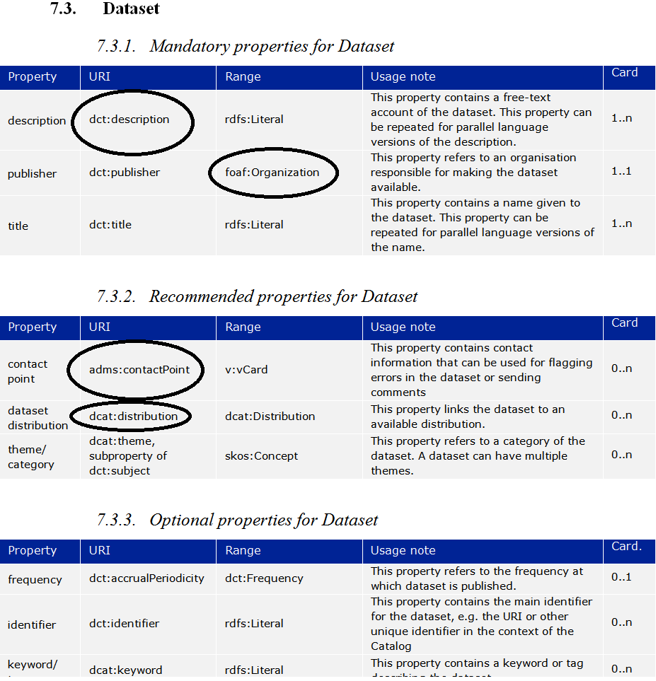
Mtech (Advance Computing and Data Science in collaboration with CDAC)

Slide 15
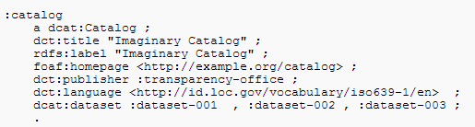
Mtech (Advance Computing and Data Science in collaboration with CDAC)
Example: description of an open dataset with the DCAT-AP
Description of the Catalogue

Slide 16
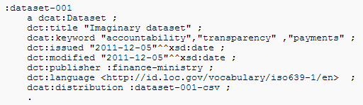
Mtech (Advance Computing and Data Science in collaboration with CDAC)
Description of the Dataset

Slide 17
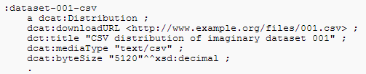
Mtech (Advance Computing and Data Science in collaboration with CDAC)
Description of the Distribution

Slide 18
Mtech (Advance Computing and Data Science in collaboration with CDAC)
Controlled vocabularies
Using thesauri, taxonomies and standardised lists of terms for assigning values to metadata properties.

Slide 19
Mtech (Advance Computing and Data Science in collaboration with CDAC)
What are controlled vocabularies?
A controlled vocabulary is a predefined list of values to be used as values for a specific property in your metadata schema.
In addition to careful design of schemas, the value spaces of metadata properties are important for the exchange of information, and thus interoperability.
Common controlled vocabularies for value spaces make metadata understandable across systems.

Slide 20
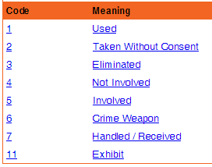
Mtech (Advance Computing and Data Science in collaboration with CDAC)
Which controlled vocabulary to be used for which type of property
Use code lists as controlled vocabulary for free text or “string” properties.
Example DCAT-AP property:
Example code list - ObjectInCrimeClass (ListPoint)

Slide 21

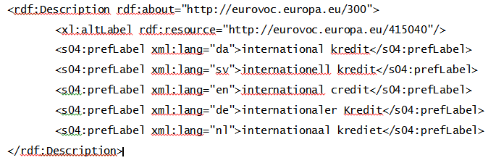
Mtech (Advance Computing and Data Science in collaboration with CDAC)
Use concepts identified by a URI for reference to “things”.
Example DCAT-AP property:
Example taxonomy with terms having a URI – EuroVoc

Slide 22
Mtech (Advance Computing and Data Science in collaboration with CDAC)
Example –Publications Office’s Named Authority Lists
• The Named Authority Lists offer reusable controlled vocabularies for:
Countries
Corporate bodies
File types
Inter institutional procedures
Languages
Multilingual
Resource types
Roles
Treaties

Slide 23
Mtech (Advance Computing and Data Science in collaboration with CDAC)
The Metadata Lifecycle
Creating, maintaining, updating, storing, publishing metadata and handling deletion of data.

Slide 24
Mtech (Advance Computing and Data Science in collaboration with CDAC)
Creating your Metadata
Metadata creation can be supported by (semi-)automatic processes.
Document properties generated in (office) tools, e.g. creation date.
Spatial and temporal information captured by cameras, sensors...
Information from publication workflow, e.g. file location or URL
However, other characteristics require human intervention:
What is the resource about (e.g. linking to a subject vocabulary)?
How can the resource be used (e.g. linking to a licence)?
Where can I find more information about this resource (e.g. linking to a Web site or documentation that describes the resource)?
How can quality information be included?

Slide 25
Mtech (Advance Computing and Data Science in collaboration with CDAC)
Maintaining your metadata
Approaches for maintaining metadata need to be appropriate for the type of data that is being published.
If data does not change, metadata can be relatively stable. Changes (bulk conversions) can take place off-line when needed.
If data changes frequently (e.g. real-time sensor data), metadata needs to be closely coupled to the data workflow and changes need to be practically instantaneous.

Slide 26
Mtech (Advance Computing and Data Science in collaboration with CDAC)
Updating your metadata – planning for change
Metadata operates in a global context that is subject to change!
Organisation – departments are established, merge with others, responsibilities are handed over.
Usage of the data – new applications emerge around data.
Reference data – controlled vocabularies evolve and get linked.
Data standards and technologies – technology lifecycle is getting shorter all the time; what will tomorrow’s Web look like?
Tools and systems – evolution of storage, bandwidth, mobile...
Metadata needs to be kept up-to-date to the extent possible, taking into account the available time and budget.

Slide 27
Mtech (Advance Computing and Data Science in collaboration with CDAC)
Storing your metadata – what are the options?
Depending on operational requirements, metadata can be embedded with the data or stored separately from the data.
Embedding the metadata in the data (e.g. office documents, MP3, JPG, RDF data) embedding makes data exchange easier.
Separating metadata from data (e.g. in a database), with links to corresponding data files makes management easier.
Depending on the availability of tools and requirements on performance and capacity, metadata can be stored in a ‘classic’ relational database or an RDF triple store.

Slide 28
Mtech (Advance Computing and Data Science collaboration with CDAC)
Handling deletions of data
In many cases, metadata must survive even after deletion of the data it describes.
Decommissioning or deletion of data happens, for example:
When data is no longer necessary.
When data is no longer valid.
When data is wrong.
When data is withdrawn by the owner/publisher
In that case the metadata should, contain information that the data was deleted, and if it was archived, how and where an archival copy can be requested.

Slide 29
Mtech (Advance Computing and Data Science in collaboration with CDAC)
Publishing your metadata – what are the options?
‘Open’ publication: direct access on URIs
This is the option most in line with the vision of Linked Open Data and allows the ‘follow-your-nose’ principle.
Make your metadata available through a SPARQL endpoint
- This allows external systems to send queries to an RDF triple store.
Requires knowledge about the schema used in the triple store.
Deferred publication: access to exported file in RDF
- Produced by converting non-RDF data to RDF.
- Allows off-line bulk harvesting and caching of data collections.
- Allows implementation of access control.

Slide 30
Mtech (Advance Computing and Data Science in collaboration with CDAC)
Metadata Quality
The quality and completeness of the description metadata of your datasets, directly affects their search ability and reuse.

Slide 31
Mtech (Advance Computing and Data Science in collaboration with CDAC)
Metadata quality
The accuracy of your metadata - are the characteristics of the resource correctly reflected?
Example: indicating the right title, the right license, the right publisher enables users to discover resources that they need.
The availability of your metadata – can the metadata be accessed now and over time into the future?
Example: making it available for indexing and downloading, and include it in in a regular back-up process.
The completeness of your metadata – are all relevant characteristics of the resource captured (as far as practically and economically feasible and necessary for the application)?
Example :indicating the licence that governs reuse or the format of the distribution enables filters on those aspects.

Slide 32
Mtech (Advance Computing and Data Science in collaboration with CDAC)
The conformance of your metadata to accepted standards – is the metadata conforming to a specific metadata standard or an Application Profile?
Example: the description of a dataset conforms to the DCAT-AP.
The consistency of your metadata – does the data not contain contradictions?
Example: not having multiple and contradictory license statements for the same piece of data.
The credibility and provenance of your metadata – is the metadata based on trustworthy sources?
Example: linking to refer data published and managed by a stable organisation (e.g. the EU Publications Office).

Slide 33
Mtech (Advance Computing and Data Science in collaboration with CDAC)
The process ability of the metadata is the metadata properly machine-readable?
Example: making the metadata of a dataset available in RDF and/or XML, and not as free text.
The relevance of the metadata – does the metadata contain the right amount of information for the task at hand?
Example: limit the information to optimally serve the users’ needs.
The timeliness of your metadata – is the metadata corresponding to the actual (current) characteristics of the resource and is it published soon enough?
Example: indicating the last modification date of the resource, thus making sure the metadata is fresh so that users will see the latest information

Slide 34
Mtech (Advance Computing and Data Science in collaboration with CDAC)
Exchanging Metadata of Datasets
Mapping your metadata to a common metadata vocabulary, such as the DCAT-AP, and exchanging the metadata across platforms.

Slide 35
Mtech (Advance Computing and Data Science in collaboration with CDAC)
Homogenising metadata
When exchanged between systems, metadata should be mapped to a common model so that the sender and the recipient share a common understanding on the meaning of the metadata.
On the schema level metadata coming from different sources can be based on different metadata schemas, e.g. DCAT, schema.org, CERIF, own internal model.
On the data (value) level, the metadata properties should be assigned values from different controlled vocabularies or syntaxes, e.g.:
Language: English can be expressed as http://publications.europa.eu/resource/authority/language/ENG or as http://id.loc.gov/vocabulary/iso639-1/en
- Dates: ISO8601 (“20130101”) versus W3C DTF (“2013-01-01”)

Slide 36
Mtech (Advance Computing and Data Science in collaboration with CDAC)
Example: Homogenising metadata about datasets
The DCAT Application Profile for data portals in Europe
The DCAT-AP can be used as the common model for exchanging metadata with open data platforms across Europe and/or with a data broker (e.g. The Open Data Interoperability Platform - ODIP).

Slide 37
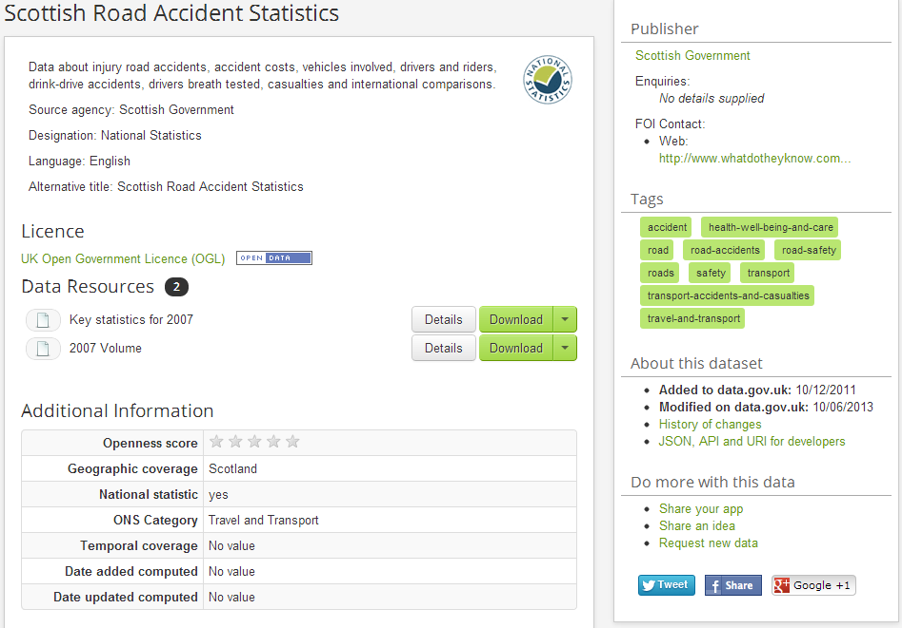
Mtech (Advance Computing and Data Science in collaboration with CDAC)
Mapping example – data.gov.uk

Slide 38
Mtech (Advance Computing and Data Science in collaboration with CDAC)
What can the Open Data Interoperability Platform do?
Harvest metadata from an Open Data portal.
Transform the metadata to RDF.
Harmonise the RDF metadata produced in the previous steps with DCAT-AP.
Validate the harmonised metadata against the DCAT-AP.
Publish the description metadata as Linked Open Data.

Slide 39
Mtech (Advance Computing and Data Science in collaboration with CDAC)
Conclusions
Metadata provides information on your data and resources. The quality of the metadata directly affects the discoverability and reuse of your the resources.
A structured approach should be followed for metadata management.
The metadata lifecycle extends the lifecycle of datasets (metadata before publication and after deletion).
Homogenised metadata enable the operation of metadata brokers, which can in turn lower the access barriers to your resources, leading to improved visibility and discoverability, and thus increasing their reuse potential.

Slide 40
Mtech (Advance Computing and Data Science in collaboration with CDAC)
References
NISO. Understanding Metadata. http://www.niso.org/publications/press/UnderstandingMetadata.pdf
Dublin City University. Chapter 3: Introduction to XML. http://wiki.eeng.dcu.ie/ee557/g2/326-EE.html
W3C. RDF Primer. http://www.w3.org/TR/rdf-primer/
http://gondolin.rutgers.edu/MIC/text/how/catalog_glossary.htm
Dublin Core. Example XML Schema. http://dublincore.org/schemas/xmls/qdc/dc.xsd
Dublin Core, Example RDF Schema. http://dublincore.org/2012/06/14/dcterms.rdf

Slide 41
Mtech (Advance Computing and Data Science in collaboration with CDAC)
The ISA Programme. DCAT Application Profile for Data Portals in Europe - Final Draft. https://joinup.ec.europa.eu/asset/dcat_application_profile/asset_release/dcat-application-profile-data-portals-europe-final-draf
ListPoint. ObjectInCrimeClass. http://www.listpoint.co.uk/CodeList/details/ObjectInCrimeClass/1.2/1
Publications Office. Countries Name Authority List. http://open-data.europa.eu/en/data/dataset/2nM4aG8LdHG6RBMumfkNzQ

Slide 42
Mtech (Advance Computing and Data Science in collaboration with CDAC)
Understanding Metadata, NISO. http://www.niso.org/publications/press/UnderstandingMetadata.pdf
Ben Jareo and Malcolm Saldanha. The value proposition of a metadata driven data governance program. Best Practices Metadata.
May 2012. https://community.informatica.com/mpresources/Communities/IW2 012/Docs/bos_30.pdf
John R. Friedrich, II. Metadata Management Best Practices and Lessons Learned. The 10th Annual Wilshire Meta-Data Conference and the 18th Annual DAMA International Symposium. April 2006.
http://www.metaintegration.net/Publications/2006-Wilshire-DAMA-MetaIntegrationBestPractices.pdf

Slide 43
Mtech (Advance Computing and Data Science in collaboration with CDAC)
Thank You..

